Slide 1


Chapter 15
Evaluation Studies:
From Controlled to Natural Settings

Slide 2
Goals
• Explain how to do usability testing
• Outline the basics of experimental design
• Describe how to do field studies
Notes:
2

Slide 3
Usability testing
Involves recording performance of typical users doing typical tasks
Controlled settings
Users are observed and timed
Data is recorded on video, and key presses are logged
The data is used to calculate performance times and to identify and explain errors
User satisfaction is evaluated using questionnaires and interviews
Field observations may be used to provide contextual understanding
Notes:
3

Slide 4
Quantitative performance measures
Number of users successfully completing the task
Time to complete task
Time to complete task after time away from task
Number and type of errors per task
Number of errors per unit of time
Number of navigations to online help or manuals
Number of users making a particular type of error
Source: Wixon and Wilson, 1997
Notes:
4

Slide 5
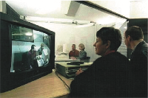
Usability lab with observers watching a user and assistant

Slide 6
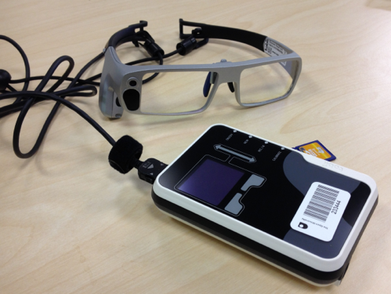
Tobii Glasses Mobile Eye-Tracking System
Source: Dalton et al., 2015, p.3891. Reproduced with permission of ACM Publications.

Slide 7
Portable equipment for use in the field
Setup used in the Chicago usability testing sessions
Source: iPad App and Website Usability Study. Used courtesy of the Neilsen Norman Group.

Slide 8
Testing the iPad usability
First study was conducted quickly in two cities: Fremont, CA and Chicago, IL
Tests had to be done quickly, as information was needed by third-party app developers
Also needed to be done secretly so that the competition was not aware of the study before the iPad was launched
Seven participants with over three months experience with iPhones

Slide 9
Testing the iPad usability (continued)
Signed an informed consent form explaining:
What the participant would be asked to do
The length of time needed for the study
The compensation that would be offered for participating
Participants’ right to withdraw from the study at any time
A promise that the person’s identity would not be disclosed
An agreement that the data collected would be confidential and available to only the evaluators
Participants were asked to explore the iPad
Next, they were asked to perform randomly-assigned specified tasks

Slide 10
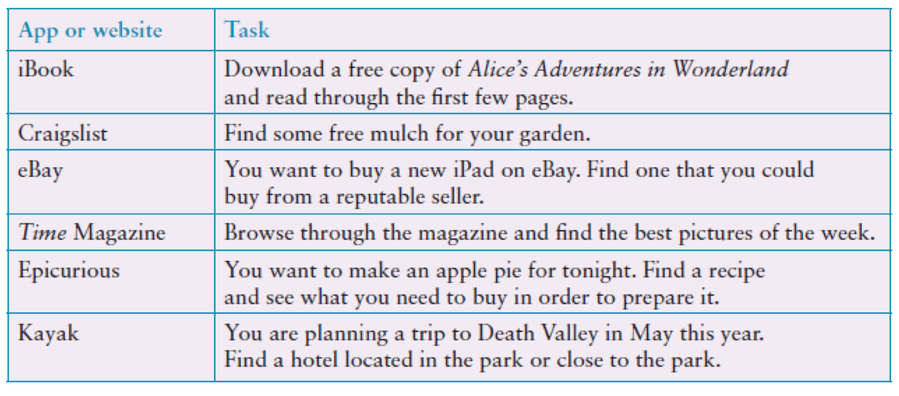
Examples of the tasks used in the iPad evaluation
Adapted from Budiu and Nielsen, 2010
Source: iPad App and Website Usability Study. Used courtesy of the Neilsen Norman Group.

Slide 11
Problems and actions
Examples of problems detected:
Accessing the Web was difficult
Lack of affordance and feedback
Getting lost in an application
Knowing where to tap
Actions by evaluators:
Reported to developers
Made available to public on Neilsen Norman Group.

Slide 12
Problems and actions (continued)
Accessibility for all users is important
Study did not address how iPad would be used in people’s everyday lives
Another study was done a year later to examine this and other issues that there was insufficient time to address in the first study

Slide 13
Usability testing conditions
Usability lab or other controlled space
Emphasis on:
Selecting representative users
Developing representative tasks
5-10 users typically selected
Tasks usually around 30 minutes
Test conditions are the same for every participant
Informed consent form explains procedures and deals with ethical issues
Notes:
13

Slide 14
How many participants is enough for user testing?
The number is a practical issue
Depends on:
Schedule for testing
Availability of participants
Cost of running tests
Typically 5-10 participants
Some experts argue that testing should continue until no new insights are gained
Notes:
14

Slide 15
Usability testing and Experiments
Usability testing is applied experimentation
Developers check that the system is usable by the intended user population by collecting data about participants’ performance on prescribed tasks
Experiments test hypotheses to discover new knowledge by investigating the relationship between two or more variables
Notes:
15

Slide 16
Usability testing and research
Usability Testing
Improve products
Few participants
Results inform design
Usually not completely replicable
Conditions controlled as much as possible
Procedure planned
Results reported to developers
Experiments for Research
Discover knowledge
Many participants
Results validated statistically
Must be replicable
Strongly controlled conditions
Experimental design
Scientific report to scientific community
Notes:
16

Slide 17
Experiments
Test hypothesis
Predict the relationship between two or more variables
Independent variable is manipulated by the researcher
Dependent variable influenced by the independent variable
Typical experimental designs have one or two independent variables
Validated statistically and replicable
Notes:
17

Slide 18
Experimental designs
Different participants (between subjects):
Single group of participants is allocated randomly to the experimental conditions
Same participants (within subjects):
All participants appear in both conditions
Matched participants (pairwise):
Participants are matched in pairs, for example, based on expertise, gender, and so on
Notes:
18

Slide 19
Different, same, matched participant design
Notes:
19

Slide 20
Field studies
Field studies are done in natural settings
“In the wild” is a term for prototypes being used freely in natural settings
Seek to understand what users do naturally and how technology impacts them
Field studies are used in product design to:
Identify opportunities for new technology
Determine design requirements
Decide how best to introduce new technology
Evaluate technology in use
Notes:
20

Slide 21
A field study of a pain-monitoring device
Monitoring patients’ pain is a known challenge for physicians
Goal of the study was to evaluate the use of a pain-monitoring device for use after ambulatory surgery
Painpad is a keypad device
It was usability tested extensively in the lab before brought into two hospitals
Goal was to understand how Painpad was used in the natural environment and as part of routines in two UK hospitals.
How pain-monitoring differed with Painpad
Notes:
21

Slide 22
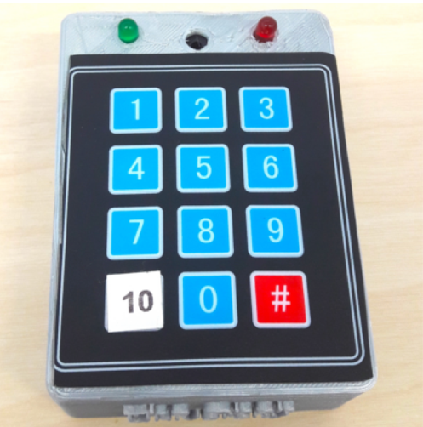
Painpad
A tangible device for inpatient self-logging of pain
Source: Price et al., 2018. Reproduced with permission of ACM Publications.

Slide 23
Data collection and participants
Two studies in two hospitals involving 54 people
13 males, 41 females
Privacy was a important concern
Hospital stay ranged from 1-7 days, mean and median age 64.6, 64.5
Patients given Painpad after surgery and prompted to report pain levels every two hours
Nurses also collected scores
All data entered into charts
Patients in one hospital were given a user-satisfaction survey when they left
Also rated Painpad on a 1-5 Likert scale
Notes:
23

Slide 24
Data analysis and presentation
Three types of data were collected:
Satisfaction with Painpad was based on questionnaire responses
Patients’ compliance with the two-hour routine
How data collected from Painpad compared with data collected by nurses
Data showed:
Satisfaction with Painpad 4.63 on Likert scale
Patience compliance was mixed: some liked it while others disliked or didn’t notice the prompts
Patients recorded more scores with Painpad than through the nurses

Slide 25
Summary
Usability testing takes place in controlled usability labs or temporary labs
Usability testing focuses on performance measures, for example, how long and how many errors are made when completing a set of predefined tasks
Indirect observation (video and keystroke logging), user satisfaction questionnaires, and interviews are also collected
Affordable, remote testing systems are more portable than usability labs
Many also contain mobile eye-tracking and other devices
Notes:
25

Slide 26
Summary (continued)
Experiments test a hypothesis by manipulating certain variables while keeping others constant
The experimenter controls independent variable(s) in order to measure dependent variable(s)
Field studies are evaluation studies that are carried out in natural settings to discover how people interact with technology in the real world
Field studies that involve the deployment of prototypes or technologies in natural settings may also be referred to as ‘in-the-wild’ studies
Sometimes the findings of a field study are unexpected, especially for in-the-wild studies that explore how novel technologies are used by participants in their own homes, places of work, or outside
Notes:
26

